Slide 1


MeetNote AI
Sr. No. | Name | Emp ID
1 | Ekta Tajne | 3193218
2 | Dhanashree Hiwase | 3193205
3 | Sharyu Mate | 3202469
4 | Yash Sathavane | 3193223
5 | Anjali Kumari | 3193228

Slide 2


Problem Statement
In modern corporate environments, meetings are often inefficient and not inclusive. Employees spend a significant amount of time taking notes instead of actively participating in discussions. As a result, important information can be missed.
Additionally, fast-paced conversations create challenges for:
  People with hearing impairments
  Non-native speakers
  Employees who struggle to keep up with real-time discussions
There is currently no easy way to make meetings searchable, track key decisions, or extract important action items automatically.

Slide 3

Objectives
  To convert speech into accurate text using AI (Whisper)
  To generate timestamped transcripts for easy navigation
  To make meetings searchable and well-documented
  To identify speakers and extract key information (future work)
  To improve accessibility for hearing-impaired and non-native speakers
  To automatically extract action items and summaries
  To enhance overall productivity and participation in meetings

Slide 4

Dataset Description
  File Type: WAV (uncompressed audio)
  Duration: ~32 seconds
  Channels: Stereo (2 channels)
  Sampling Rate: 48,000 Hz
  Format: PCM (high-quality audio)

Slide 5
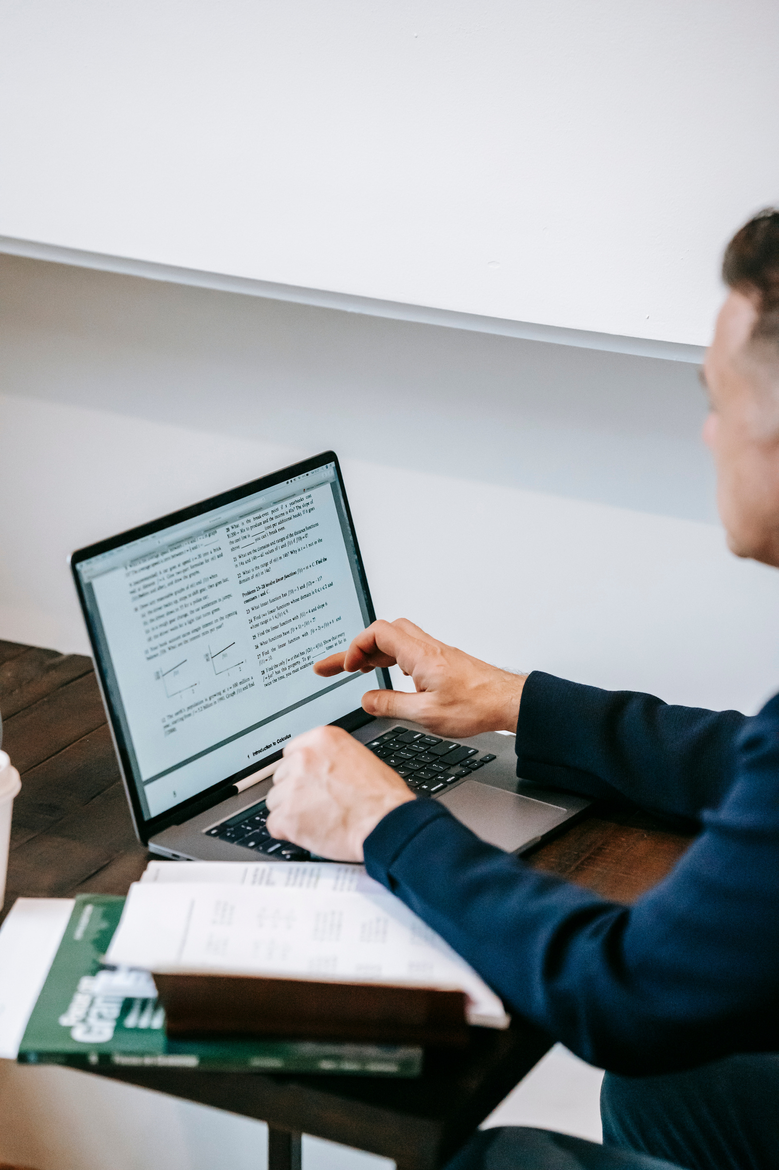
Tech Stack
Frontend:
Libraries:
React.js
NumPy, PyTorch
Backend:
Communication:
Python(Flask/FastAPI)
REST APIs
AI Model:
OpenAI Whisper

Slide 6
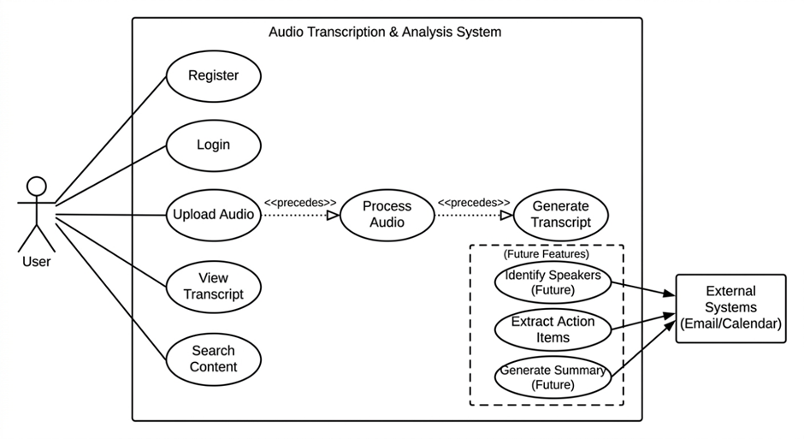
Use case: MeetNote AI

Slide 7
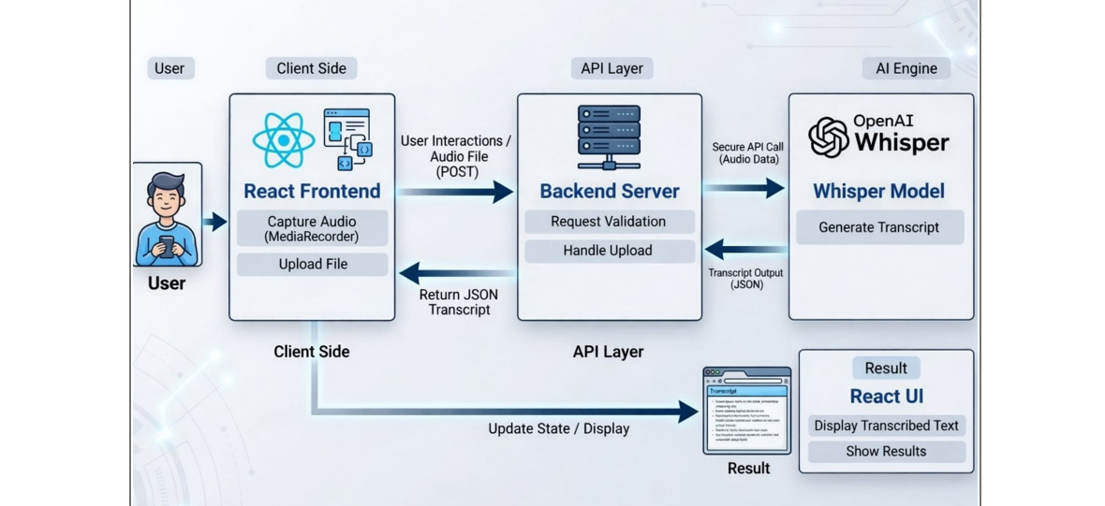
Architecture

Slide 8
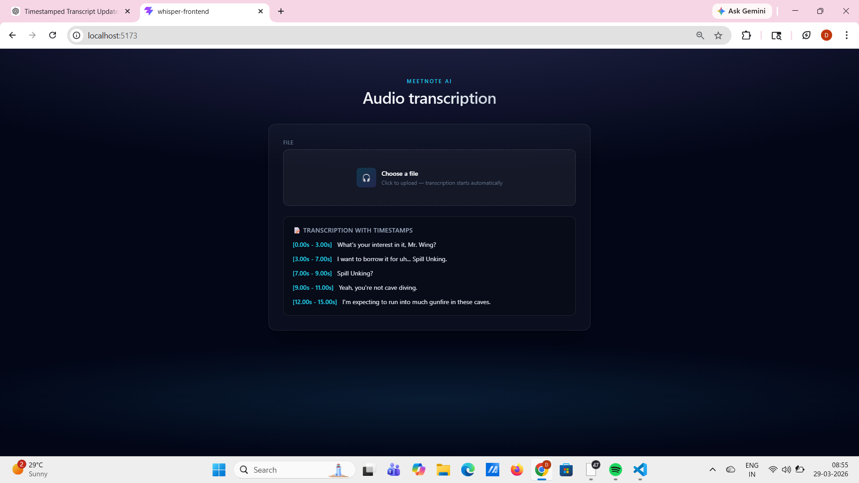
OUTPUTS:

Slide 9
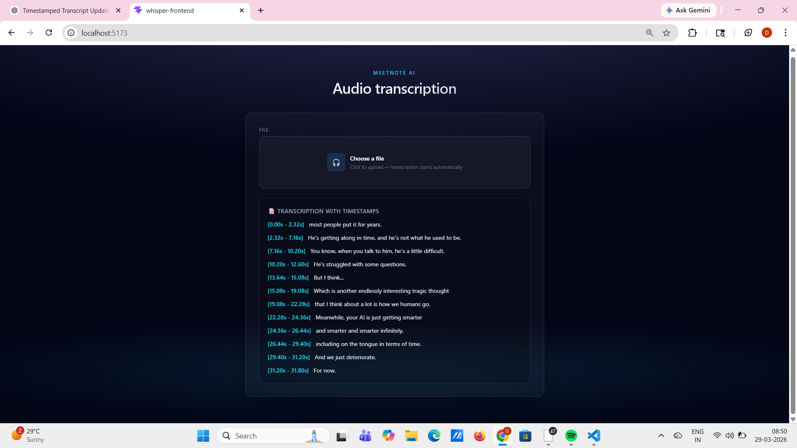

Slide 10

THANK YOU
Thank You

